Slide 1
Strassen's Matrix Multiplication
Sibel KIRMIZIGÜL

Slide 2

Basic Matrix Multiplication
Suppose we want to multiply two matrices of size N x N: for example A x B = C.
C₁₁ = a₁₁b₁₁ + a₁₂b₂₁
C₁₂ = a₁₁b₁₂ + a₁₂b₂₂
C₂₁ = a₂₁b₁₁ + a₂₂b₂₁
C₂₂ = a₂₁b₁₂ + a₂₂b₂₂
2x2 matrix multiplication can be accomplished in 8 multiplication.(2^{log}₂⁸ =2³)

Slide 3
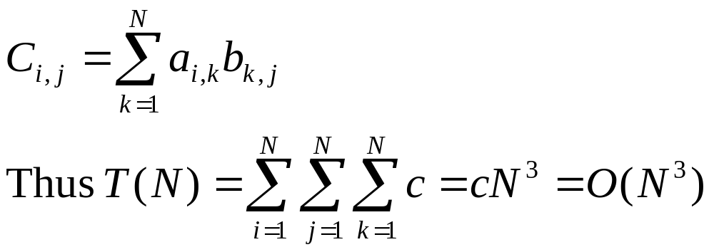
Basic Matrix Multiplication
void matrix_mult (){
for (i = 1; i <= N; i++) {
for (j = 1; j <= N; j++) { compute C_{i,j}; }
}}
algorithm
Time analysis

Slide 4
Strassens’s Matrix Multiplication
Strassen showed that 2x2 matrix multiplication can be accomplished in 7 multiplication and 18 additions or subtractions. .(2^{log}₂⁷ =2^{2.807})
This reduce can be done by Divide and Conquer Approach.

Slide 5
Divide-and-Conquer
Divide-and conquer is a general algorithm design paradigm:
  Divide: divide the input data S in two or more disjoint subsets S₁, S₂, …
  Recur: solve the subproblems recursively
  Conquer: combine the solutions for S₁, S₂, …, into a solution for S
The base case for the recursion are subproblems of constant size
Analysis can be done using recurrence equations

Slide 6
Divide and Conquer Matrix Multiply
A × B = R
A₀ | A₁
A₂ | A₃
B₀ | B₁
B₂ | B₃
A₀×B₀+A₁×B₂ | A₀×B₁+A₁×B₃
A₂×B₀+A₃×B₂ | A₂×B₁+A₃×B₃
×
=
Divide matrices into sub-matrices: A₀ , A₁, A₂ etc
Use blocked matrix multiply equations
Recursively multiply sub-matrices

Slide 7
Divide and Conquer Matrix Multiply
A × B = R
a₀
b₀
a₀ × b₀
×
=
Terminate recursion with a simple base case

Slide 8
Strassens’s Matrix Multiplication
P₁ = (A₁₁+ A₂₂)(B₁₁+B₂₂)
P₂ = (A₂₁ + A₂₂) * B₁₁
P₃ = A₁₁ * (B₁₂ - B₂₂)
P₄ = A₂₂ * (B₂₁ - B₁₁)
P₅ = (A₁₁ + A₁₂) * B₂₂
P₆ = (A₂₁ - A₁₁) * (B₁₁ + B₁₂)
P₇ = (A₁₂ - A₂₂) * (B₂₁ + B₂₂)
C₁₁ = P₁ + P₄ - P₅ + P₇
C₁₂ = P₃ + P₅
C₂₁ = P₂ + P₄
C₂₂ = P₁ + P₃ - P₂ + P₆

Slide 9
Comparison
C₁₁ = P₁ + P₄ - P₅ + P₇
= (A₁₁+ A₂₂)(B₁₁+B₂₂) + A₂₂ * (B₂₁ - B₁₁) - (A₁₁ + A₁₂) * B₂₂+
(A₁₂ - A₂₂) * (B₂₁ + B₂₂)
= A₁₁ B₁₁ + A₁₁ B₂₂ + A₂₂ B₁₁ + A₂₂ B₂₂ + A₂₂ B₂₁ – A₂₂ B₁₁ -
A₁₁ B₂₂ -A₁₂ B₂₂ + A₁₂ B₂₁ + A₁₂ B₂₂ – A₂₂ B₂₁ – A₂₂ B₂₂
= A₁₁ B₁₁ + A₁₂ B₂₁

Slide 10
Strassen Algorithm
void matmul(int *A, int *B, int *R, int n) {
if (n == 1) {
(*R) += (*A) * (*B);
} else {
matmul(A, B, R, n/4);
matmul(A, B+(n/4), R+(n/4), n/4);
matmul(A+2*(n/4), B, R+2*(n/4), n/4);
matmul(A+2*(n/4), B+(n/4), R+3*(n/4), n/4);
matmul(A+(n/4), B+2*(n/4), R, n/4);
matmul(A+(n/4), B+3*(n/4), R+(n/4), n/4);
matmul(A+3*(n/4), B+2*(n/4), R+2*(n/4), n/4);
matmul(A+3*(n/4), B+3*(n/4), R+3*(n/4), n/4);
}
Divide matrices in sub-matrices and recursively multiply sub-matrices

Slide 11
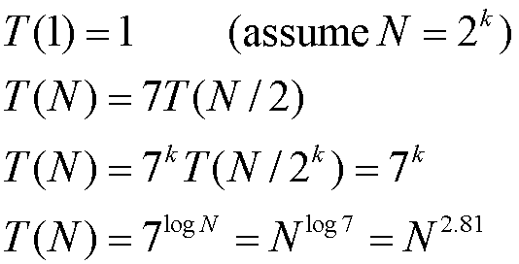
Time Analysis

